Slide 1



AN OVERVIEW OF SOLAR ENERGY SYSTEMS AND TECHNOLOGY
Prepared by the North Central Texas Council of Governments
www.nctcog.org and www.gosolartexas.org
Prepared September 2016
Notes:
Welcome everyone.
[Audience Engagement: Consider doing a show of hands to show what percent of the audience has experience with Solar Energy systems. Or ask the audience a question about whether anyone has any systems installed or has considered installing a system on their home or business.]

Slide 2
Presentation Overview
Texas: The State of Solar
Solar 101 Basics: Terminology and Equipment
Considering Installing a Solar Energy System? Now What?
Solar Energy Resources
Notes:
Today we are going to talk about a variety of topics including (click through the list of agenda items).

Slide 3
Texas: The State of Solar
Texas has more solar energy potential than any other US state. Currently, Texas ranks 10th in the country in installed solar capacity.
Notes:
According to the Energy Information Administration, Texas is responsible for 10% of our nation’s electricity consumption, making it the greatest electricity consuming state in the U.S. In addition, Texas has the fastest growing population among the five most populous states. The combination of these factors amounts to 450,000 new consumers or 6,800 additional GWh each year electricity that is needed to power homes and businesses. Since most of Texas is part of the Electric Reliability Council of Texas (ERCOT) grid, which is somewhat isolated from the rest of the country, Texas needs to find ways to generate this new electricity need within its own borders.

Slide 4
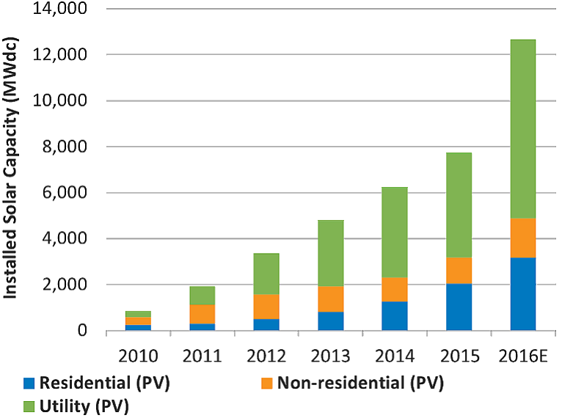
Yearly US Solar Installations
Source: Solar Energy Industries Association Q2 2015 Fact Sheet, December, 2015, www.seia.org
Notes:
Prices for solar panels (the hardware) have fallen drastically in the last few years. Today, solar panels are about half the price they were in 2008.
This decline in price has made installation more economical for the average homeowner or business owner. Residential Photovoltaic (PV) installations have drastically increased since 2010, as shown in the chart. As of 2016, it is estimated that over 12,000 Megawatts (MW) of solar capacity will be installed compared to less than 1,000 MW of installed capacity in 2010.

Slide 5
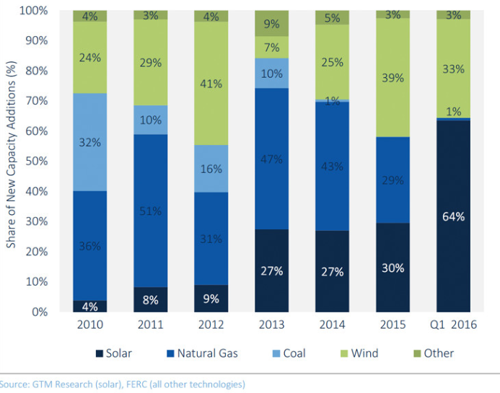
Share of New US Electric Generating Capacity Additions (2010 – Q1 2016)
94% Increase in 6 years
Acquired: http://www.seia.org/research-resources/solar-market-insight-report-2016-q2; August 2016
Notes:
As the number of solar installations have been growing, solar consequently makes up a larger share of the new US electric generating capacity additions. This chart shows that in 2010, solar made up 4% share of the electric generating capacity additions compared to 2016 where it now consists of 64% of the new electric generating capacity additions. This chart also shows a fairly significant decrease in coal capacity additions and some decline in natural gas capacity additions.

Slide 6
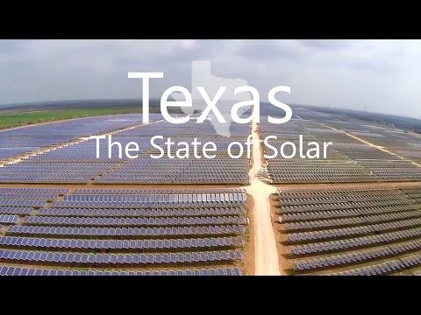
Video
Notes:
Now, we will watch a short video that covers the benefits of solar energy and Texas’ unique position to harness this natural resource.

Slide 7
Texas’ Benefits From Solar
Availability of Abundant Resource
Energy Security
Meet Growing Energy Demand
Efficiency
Improve Air Quality
Economics and Financial Stability
Notes:
As touched on in the video, Texas can benefit from solar energy for a variety of reasons.
Texas is blessed with an abundance of solar resources. Texas has the second greatest technical potential for photovoltaic (PV) rooftop installations.
Solar is an abundant local resource, and expansion of solar can help Texans, and all Americans, improve energy independence.
Much solar is produced and used at the same site, which reduces efficiency losses associated with the transmission system.
Texas is one of the fastest growing states in terms of population size and economic growth. There is a need to generate more electricity to keep up with demand.
Solar is a zero-emission technology. Increased deployment of solar has the potential to help reduce harmful emissions that contribute to ozone formation and health concerns.
Due to combination of federal incentives and falling hardware and installation costs, solar is beginning to reach grid parity with conventional energy sources. In addition to being cost-competitive with higher emitting energy sources, solar is less exposed to price volatility associated with the economics of oil and gas. Additionally, solar contracts can be signed for 20-25 years at stable prices which translates into a stable bill for energy end-users.

Slide 8
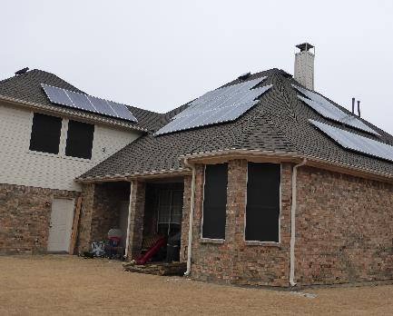
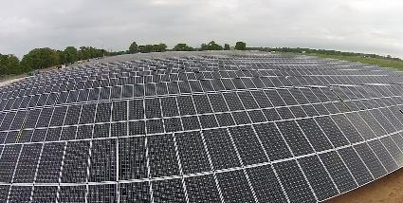
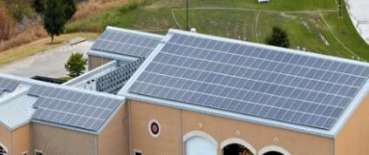
Solar is Here!
Municipal and School Solar Commitments
Large Solar Projects and Community Solar
Solarize Projects
Austin, Bridgeport ISD, Dallas, Denton, Duncanville, Georgetown, Irving ISD, McKinney, Pasadena ISD, Presidio ISD, San Antonio
CPS Energy
CoServ Electric
Austin Energy
MP2 Energy
REI, Kohl’s, Target, Ikea, FedEx
Plano
Houston
Garland
Wells Branch
Gillespie County
Notes:
In addition to homeowners and business owners investing and installing solar on their properties, many local governments, school districts, and large scale commercial projects have been installed or are in the planning stages.
Several municipally owned utilities, such as Austin Energy and CPS Energy (in San Antonio) and electric cooperatives have planned and built large scale solar arrays that are providing power for their customers, diversifying their energy portfolio, and creating a positive image.
Additionally, innovative cooperative purchase models such as Solarize projects, have been organized by several communities around Texas. These models help reduce costs even further by bundling multiple customers and purchases of solar installations together, thereby reducing costs for installation and the installers acquisition costs.

Slide 9
Important Solar Legislative Notices for Texas
TEXAS LAWS
HB 362 (passed in 2011)
  This bill updated the Texas Property Code, Sec. 202.010 and 202.011
  Prevents HOAs from restricting solar panels on homes. However, the home owner must follow the requirements of the law, and the HOA does have a voice in where they may be installed as determined by the amount of energy they'll generate in a given location.
  The above aside, the HOA cannot simply deny the installation.
SB 1626 (passed in 2015)
  The "neighborhood in development" loophole had allowed residential developers the option to block solar installations until the last lot was sold. Due to SB 1626, this loophole has been reduced to only apply to developments with fewer than 51 planned residential units (effective 9/1/2015).
TEXAS TAX BREAKS
Residential renewable energy systems are also eligible for tax exemptions on assessed valuation. A form can be filed with the County of residence.
A State of Texas property tax exemption exists involving solar, wind, biomass, and anaerobic digestion for business installation or construction of such systems.
Businesses that either use or manufacture or install solar or wind energy can receive franchise tax deductions and/or exemptions.
Source: http://seco.cpa.state.tx.us/re/incentives-taxcode-statutes.php
Notes:
In Texas, ALL HOAs must allow the installation of solar panels. It’s the law. The State of Texas passed HB362 in 2011, prohibiting HOAs from restricting solar panels. There ARE some steps the homeowner must follow, but they ARE allowed to install solar panels in any HOA. Cities are advised to review HB362 before considering restricting solar panels.
Additionally, there are Tax Breaks that business and homeowners can take advantage of related to Solar energy systems including exemptions on the assessed valuation, property tax exemptions, and franchise tax deductions and/or exemptions for businesses.

Slide 10
Solar 101 Basics: Terminology and Equipment
The Lone Star State has installed 534 megawatts (MW) of solar capacity, enough to power 57,000 homes.*
*Source: Solar Energy Industries Association, SEIA.org/smi. Acquired August 2016. Data as of December 2015.
Notes:
When evaluating solar energy systems, it is important to have a basic understanding of the terminology. This will assist you with having conversations with potential installers and make you an informed customer so that you know what to ask about, what equipment will be needed as part of the installation on your home or business, and prepare you for evaluating the return on investment from your system.

Slide 11
Solar 101 Basics: Electricity, Power, and Energy Terminology
Photovoltaic (“PV”):
Electricity from light.
Solar Cell:
Converts sunlight into electricity.
Photovoltaic Module:
Multiple solar cells connected in one unit.
Photovoltaic Array:
Multiple photovoltaic modules.
Direct Current ("DC"):
Electricity that flows in one direction.
Alternating Current ("AC"):
Electricity that changes direction.
Electrical power at any given moment.
Watts:
Watt-hours:
Quantity of electrical power over time.
Kilo:
1,000 of something.
1,000 watts = 1 kilowatt
1,000 watt-hours = 1 kilowatt-hour
Inverter:
Device that changes DC to AC.
Notes:
[Click through each definition]

Slide 12
Solar 101 Basics: Financial Terminology
Grid-Connected:
Connected to the utility lines.
Leased System:
On the business, owned by a third-party.
Net Metering:
Credit for energy sent back to the utility.
Net Zero:
Energy credit balances energy consumed.
Parity:
Energy value balances loan payment.
"PPA":
Power Purchase Agreement.
"REP":
Retail Electric Provider.
Zero Energy Home:
Energy value produced = value consumed.
Notes:
[Click through each definition]
Several of these terms will be address later in the Financing section of this presentation.

Slide 13
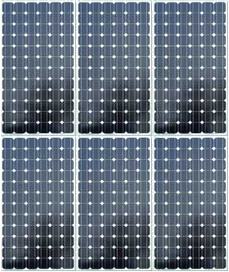
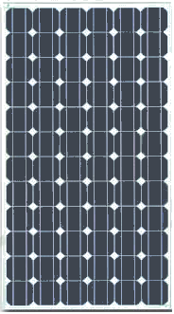

Solar 101 Basics: Equipment
PV SOLAR ARRAY
(More than one Module)
PV SOLAR MODULE (lots of cells)
Array
PV SOLAR CELL
Module
Cell
Notes:
A Solar cell is the basic component that converts sunlight into electricity.
Photovoltaic systems, composed of solar cells, are able to convert sunlight directly into electricity. This, as described by the U.S. Department of Energy (DOE), is because PV cells are electricity-producing devices made of semiconductor materials. Simply put, a solar panel works by allowing photons, or particles of light, to knock electrons free from atoms, generating a flow of electricity.
When you have lots of solar cells connected together in one unit, they form a solar module. And when you have more than one solar modules, a solar Array is formed. A typical solar module or panel is 5 ½ feet by 3 ¼ feet (for a typical residential installation).
Are Solar Panels Heavy? No. They only LOOK heavy due to the aluminum frame. A 250 watt solar panel (typical size as of the date of this FAQ) weighs approximately 40 lbs. A 2,500 watt “array” - including the mounting rack - will add approximately 2.5 pounds per square foot to the roof.
Does homeowners' insurance cover solar panels?
Often, yes. Some companies will not however. The homeowner will need to ask their insurance company. If the insurance company you’re with doesn’t cover solar panels, and you want to add them to your home, shop around for a different insurance company.
Many insurance companies offer coverage.
Check with your insurance company before you install!

Slide 14
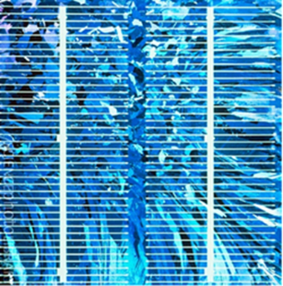


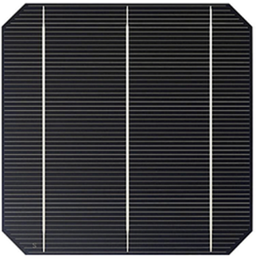
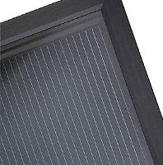
Solar 101 Basics: Equipment
Most solar cells are black to various shades of blue…
Some “thin film” types are brown to gray
Blue: Polycrystalline Cell
Amorphous Silicon
Cadmium Telluride
Black: Monocrystalline Cell
Copper Indium Gallium Selenide
Notes:
Most solar cells are either a black color or a blue color. The major difference is the manufacturing of the cells and the way the silica crystals grow. The Polycrystalline Cell (bluish cell) is a little less efficient than the black, Monocrystalline cell.
There are also some thin film products on the market that can be colored brown to gray colors. These products are made from different types of materials. These thin films can be used for multiple applications.
Solar cells must absorb as much light as possible. Changing their color would require a different mix of metals, substantially reducing their energy output (it’s been tried). Cells are black, gray, or very dark blue because they absorb most of the light.

Slide 15
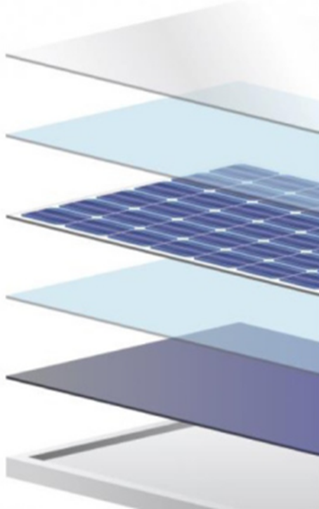
Solar 101 Basics: Equipment
Tempered Glass
  Ethelene Vinyl Acetate (EVA)
  Solar Cell
  EVA
  Backsheet (seals environment out)
  Aluminum Frame (supports snow, withstands wind)
Notes:
All of these components make up a solar module.
Will hail damage my solar panels? Most solar panels use low-iron tempered glass and are designed to withstand hail that is 25 mm (1 inch) at 80 km/h (50 mph). If you live in a hail-prone area, you should ask your contractor or the solar panel manufacturer for their hail impact test data.
How long do solar panels last? Almost all panels are guaranteed to last between 25 and 30 years; and some are able to produce electricity for much longer! Properly installed solar panels should require little maintenance, making for an excellent return on investment. To note, the inverter (converting DC current to AC current) will need to be replaced after 10 to 15 years.

Slide 16
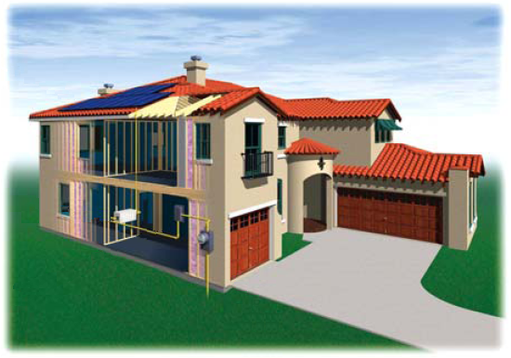
Basic Overview:
Solar Electricity Works Like this…….
Photovoltaic modules
convert sunlight into
electricity.
"Inverter" - converts
solar DC into
household AC.
Utility meter: Measures power consumed and all excess power fed back to the utility grid.
The solar electricity serves the building loads first. Any excess is fed out to the utility grid to the neighbors, and may accrue credit to the owner.
Notes:
If the power grid goes down, will I still have electricity?
Most of the time, no, but it depends. If your system is connected to the grid, it will shut down to protect your electric provider's linemen. If you happen to have a battery backup system, the power would come back on after a brief outage and would continue to provide electricity until the storage is depleted. On the other hand, if your home is off-grid, you will not be impacted if the power grid is compromised. You can learn more from the Texas Solar Energy Society.
What is Net Metering?
In some places around the country, utility companies offer net metering, which means solar owners earn money from their electricity provider if their installation generates more electricity than they can immediately use. In these cases, the excess power flows back to the utility grid, and utility companies will pay or give credit for this excess. Net Metering is also known as Solar Buyback.
Texas does not require that utilities offer net metering, so this choice is up to the retail electric provider (or muni/coop utility). Check with your electricity provider to see if a net metering or buy-back option is available to you. You can also search on www.powertochoose.org, we will discuss more on this coming up.

Slide 17
Considering Installing a Solar Energy System?...Now What?
Homes with rooftop solar command a premium of $15,000 (for a typical size 3.6 kW PV system) and sell up to 50% faster than non-solar homes.*
*Source: Sandra Adomatis and Ben Hoen. Appraising into the Sun: Six-State Solar Home Paired-Sale Analysis. Lawrence Berkeley National Laboratory. 2015
Notes:
So you are considering installing solar, how can you get started?
The first steps to take are to educate yourself on the basics of solar energy systems and costs; and to determine whether solar is workable for your home or business. Helpful resources can be found at the gosolartexas.org, which provides an introduction to solar basics, tools for determining if solar is right for your property, discussion of financing options, information on permitting and inspections, and suggestions on finding certified installers.

Slide 18
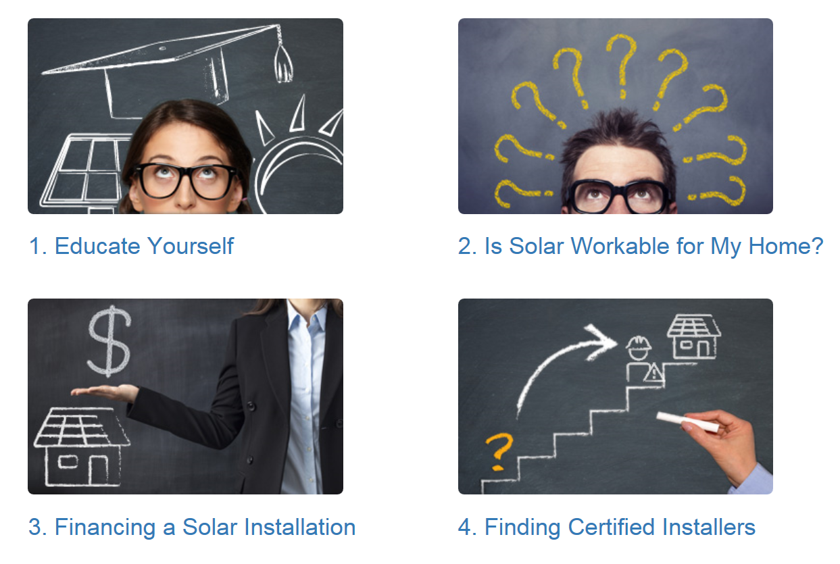
Visit GoSolarTexas.org
Notes:
The Gosolartexas.org website is a great clearinghouse of information. This is a good first stop for Home Owners, business owners, local governments, and other audiences. Most people want to know What percentage of my total electrical costs will the PV system cover? and How much electricity does a PV system generate? The answer to these questions depends on several variables that must be considered to estimate the annual energy produced by a PV system:
1. How much energy do you consume?
2. Where is the system located?
3. How large is the system?
4. What direction does it face?
5. At what angle is it tilted?
6. Are there any shade sources that reduce output?
These .. plus a free on-line program called "PV Watts" will allow you estimate the amount of energy and its approximate value.
The next few slides walks you through the most basic information and potential resources a customer can use to begin to estimate the answers to these questions.

Slide 19

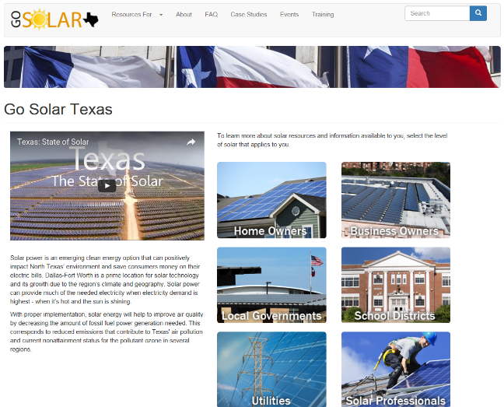
A FEW RESOURCES TO EXPLORE
Many more resources are available at gosolartexas.org
Resources for:
Homeowners
Business Owners
Local Governments
School Districts
Utilities
Solar Professionals (Industry, Real Estate Agents, Appraisers, etc.)
Go Solar Texas
Notes:
You are already well on your way to becoming educated on solar energy systems. Many additional resources for other audiences, FAQs, videos, and case studies are available at gosolartexas.org.
Slide 28 also has links to a number of additional resources used in this presentation in addition to others
Determining whether your home or business is ready for solar is the next step we will focus on.

Slide 20
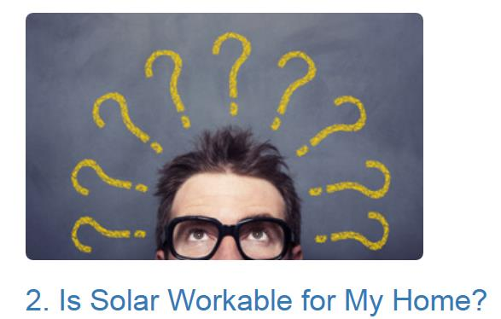

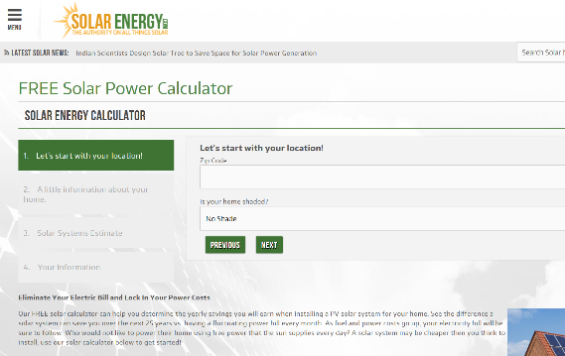
A FEW RESOURCES TO EXPLORE
A few considerations that will impact the Return on Investment (ROI):
Orientation of your home or business (does it have a South or Southwest facing roof that receives ample sunlight)
What financial incentives are currently available
What Retail Electric Provider you have and whether there is one who will compensate you for electricity generated
The type of system you want installed
Price of electricity
How much electricity you consume annually
Energy Sage: Get Competing Solar Quotes Online
Solar Energy: Free Solar Power Calculator
Notes:
How should I prepare my home/business for solar?
There are two main things to consider when preparing your home for solar: 1) the condition of your roof, and 2) the energy efficiency of your home.
First, before installing solar panels, you'll want to ensure that your roof is in good condition and have it inspected by a professional roof contractor. Roof contractors will consider the roof age, roofing materials, ventilation, and whether there are visible signs of damage. Most reputable roofing contractors provide free estimates, so this should not incur an additional cost.
Second, you can maximize the benefits of solar by making your home as energy efficient as possible. For instance, you can weatherize your home and replace old inefficient appliances with Energy Star models. Learn more about home energy efficiency from the U.S. Department of Energy.
Once you have ensured your roof is in good condition and your home is as energy efficient as possible, there are a few considerations that will impact whether your home/business is suitable for solar and the return on investment (ROI) of a solar installation.
First, the orientation of your home or business is very important. A south or southwest facing roof that receives ample sunlight is the ideal location for solar panels. This will provide the maximum generation.
Second, you will want to review your current electricity consumption over the course of a year and determine the size of a system you will need – it’s important to not oversize your system. You need to determine your annual electricy usage in kWh.
Third, evaluate what financial incentives are currently available for you to take advantage of (covered on the next few slides)
Fourth, evaluate what Retail Electric Provider (REP) you have
Retail Electric Provider considerations: If you have or are going to have a PV solar system installed, it is recommended that you evaluate electricity rate plans that compensate you for electricity sent back to the grid. The current PowerToChoose website (www.powertochoose.org) offers a separate search for renewable energy buyback plans here - http://powertochoose.org/en-us/Content/Resource/Selling-Renewable-Power (or from the main home page, select “Renewable Power” in the bottom menu to navigate here).

Slide 21
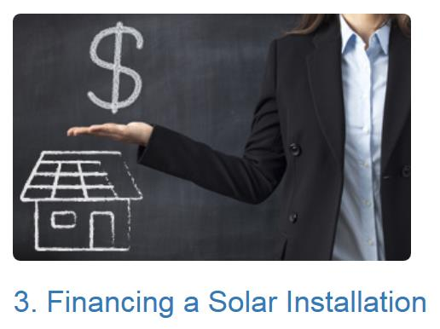
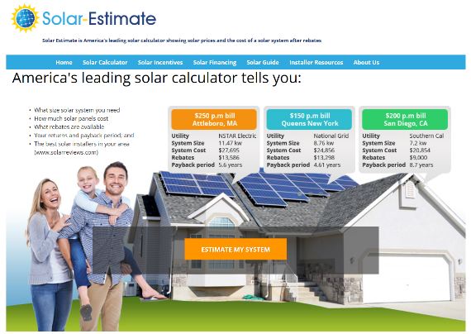
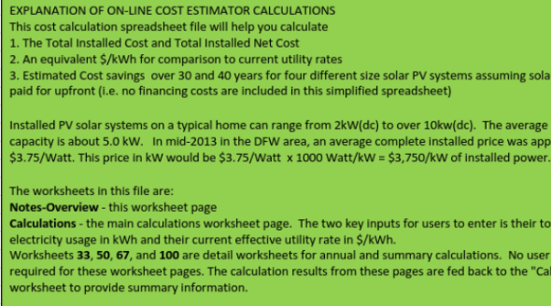
A FEW RESOURCES TO EXPLORE
Like buying a car, there are different options to consider to best meet your needs, and a variety of incentives can help make the economics work:
Step 1) Calculate the Return on Investment (ROI)
Ask your installer to include an ROI estimate on their quote or, develop your own or validate an installers quote by using the tools provided here
Most installer quotes take existing incentives into account, so make sure you can claim incentives for an accurate ROI
Solar Estimator: Shows Solar Prices and Cost of Systems after Rebates
Plano Solar Advocates: On-Line Cost Estimator Tool
Notes:
The cost of a solar installation depends on multiple factors:
How you plan to finance the installation—cash, loan, or lease;
How much electricity you use;
The size of the installation; and
What incentives are available to you.
In recent years, the cost of solar power has dropped significantly (73% since 2006), largely due to federal and state incentives. That being said, solar installations can involve a sizable upfront financial commitment. On average the cost of solar installations range from $15k to $29k for a system sized between 4kW and 8kW (the average size of a residential solar system in the US is 5 kWh). This will include the cost of all components- solar panels, panel mounts, inverter-- and labor associated with installation. Typical payback periods, or the amount of time required to recover your cash outlay, range from 4 to 10 years. To learn more about local incentives, visit our financing page or the comprehensive Database of State Incentives for Renewable & Efficiency (DSIRE) website.
Your first step will be to calculate what the return on Investment, or ROI, would be on the installation
[Go through bullets on slide as desired]

Slide 22

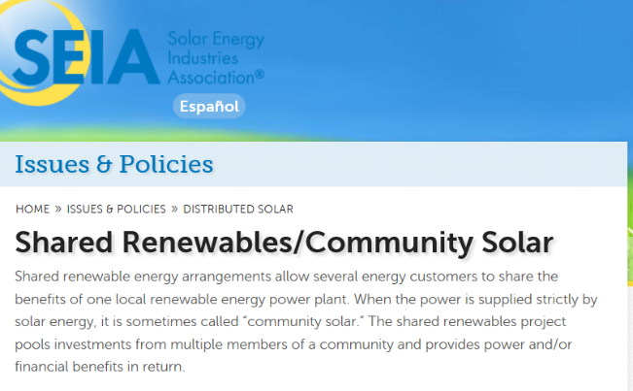
A FEW RESOURCES TO EXPLORE
Like buying a car, there are different options to consider to best meet your needs, and a variety of incentives can help make the economics work:
Step 2) Evaluate Payment Options (see Slide 23/25 also)
One important distinction is whether the system is for residential or commercial application (incentives differ as does the payment options available)
Consider differences between a Purchase, Lease, or Power Purchase Agreement model
Incentives and financing options depends on whether residential or commercial installation
Consider Shared Renewables/Community Solar program if your home/business is not suitable for solar energy installation
Residential Solar 101: Solar Finance Overview
SEIA: Shared Renewables/Community Solar
Notes:
The second step when looking into how to finance a system, is to evaluate payment options
[Go through bullets on slide as desired, next slide more fully walks through the difference between purchase, lease, and power purchase agreement ]

Slide 23
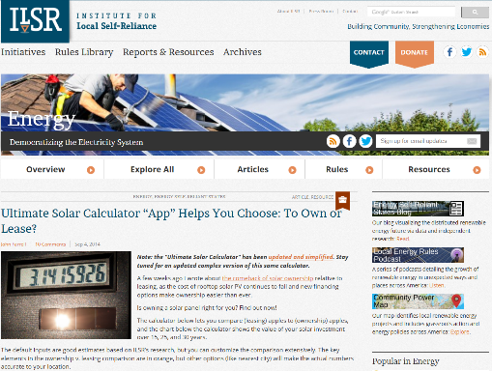
A FEW RESOURCES TO EXPLORE
Three Typical Financing Options
An App That Helps You Choose To Own or Lease
Purchase | Lease | Power Purchase Agreement
Requires capital to finance | Often requires down payment | Typically no down payment
Property owner responsible for operations/maintenance | System owner is responsible for operations/maintenance | System owner is responsible operations/maintenance
Property owner claims rebates/incentives | System owner (3rd Party) monetizes rebates/incentives | System owner (3rd Party) monetizes rebates/incentives
Generally most advantageous to private (taxable) entities | Lease payment is fixed rate not tied to the power generated – typical 15 year term | Purchase the power generated at a fixed rate – typical 15 year term
Not a common approach for government entities due to lack of tax benefits (unless grants or loans are available) | Common for government entities where PPA is not allowed
Notes:
There are three main approaches to financing a system: through purchase, lease, or a power purchase agreement.
Purchase or leasing is generally more suitable for homeowners and small businesses, whereas power purchase agreements will be used by a larger commercial project or a utility.
Terms and benefits of the three financing approaches are seen in the table.
The Institute for Local Self-Reliance has developed an app that can help you evaluate the pros and cons of which financing approach to use.

Slide 24
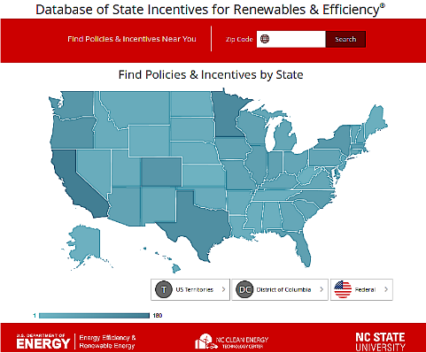
A FEW RESOURCES TO EXPLORE
Step 3) Evaluate Available Incentives
Incentives for Solar Installations: The Database of State Incentives for Renewables & Efficiency® (DSIRE) lists all known state, regional, and local incentives and is the best initial resource to use to identify incentives for residential or business.
Utility Company Pay/Credit:
There are some utility companies that pay or give credit for excess solar energy. Visit www.powertochoose.com to find a utility company offering these programs.
www.dsireusa.org
Power to Choose Available Purchase Offers
Property Tax Exemption
Fannie Mae Green Initiative Loan Program
Business Energy Investment Tax Credit (ITC)
Property Assessed Clean Energy (PACE)
Rural Energy for America Program (REAP)
Renewable Energy Buy-Back Programs
Residential Renewable Energy Tax Credit/Business Energy Investment Tax Credit
Property Tax Exemption
SECO LoanSTAR
Rapid Depreciation (MACRS)
Notes:
The third step is to evaluate available incentives
Incentives are available for both residential and business solar installations. The Database of State Incentives for Renewables and Efficiency (DSIRE) lists all the known state, regional, and local incentives available. This is the best resource to check to understand on a state by state basis, what incentives might be available. Some of the more popular incentives in Texas are shown on this slide in the yellow box, but do check out the DSIRE website to learn more about public and private incentives.
Some utilities or Retail Electric Providers (REPs) do provide incentives for solar to their customers, so check to see if these are available in your area. Usually, these are also listed on the DSIRE website, but if you don’t see one for the utility/REP in your area, contact them to see if a program might be in the works (or encourage them to start one).
While looking into this, also ask if they provide Net Metering or Solar BuyBack. As previously discussed, this option allows utility customers to apply the electricity generated by their own devices against their electric bills. If they produce more than they consume, the utility pays or credits them for the excess. Texas does not currently require that utilities offer net metering, so it is up to the utility/REP to offer it. There are a handful in Texas that currently offer this as an incentive. Again, visit the Power to Choose website and check out the available purchase offers to find a utility company that offers a program that pays you or gives you credit for any excess energy you produce.

Slide 25
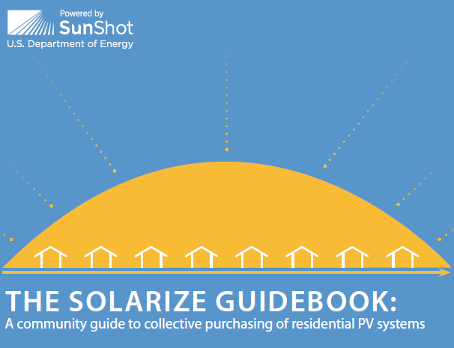
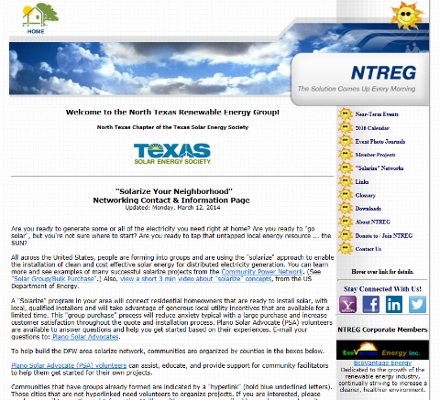
A FEW RESOURCES TO EXPLORE
Other Ways to Purchase Solar Energy:
Community Solar (aka shared solar or solar gardens): Community solar is the sharing of renewable solar power from a centralized source. Realize the benefits of solar without requiring an solar installation of their own
Solarize Campaigns: Group purchase option where participants benefit from economies of scale – resulting in a lower cost per installed KW. Several examples of Solarize campaigns are here that could be replicated:
Solarize Plano
Solarize Garland
Solarize Wells Branch
NREL: The Solarize Guidebook
NTREG Solarize Information
Notes:
Some residents and business owners will find that their home or business is not suitable for a solar installation due to trees, neighboring buildings or other shade producing structures, orientation, roof age, age of structure, etc. If you go through the initial steps of evaluating your home for a solar energy installation and find that your home or business may not be a good candidate, there are some alternatives to consider. Community solar, also known as shared solar or solar gardens are becoming more prevalent throughout the US and several projects in Texas are operational, with more planned for development in the coming years. For more information on available community solar programs being offered by utilities in Texas, visit http://www.gosolartexas.org/community-solar.
[Additional details on Community Solar: Community solar is the sharing of renewable solar power from a centralized source, like a large solar array or solar farm. While there are many different structures for participants to participate in these programs, the basic concept is a solar facility built as a stand-alone system, where people or business can invest in, or purchase "shares", and be credited on their own utility bills for the solar energy generated.]

Slide 26
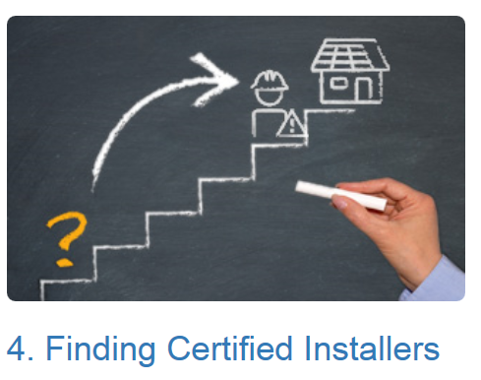
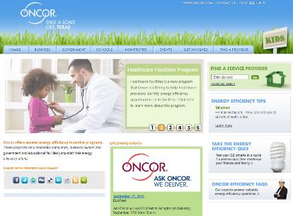
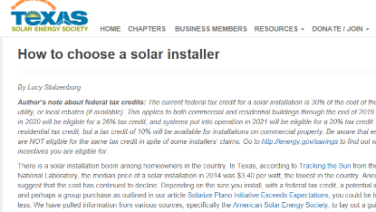
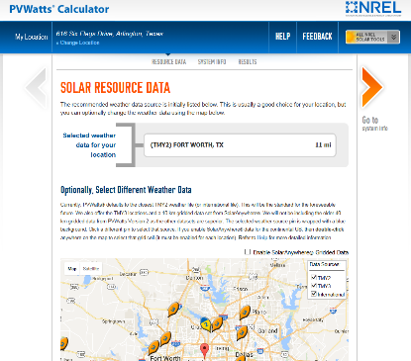
A FEW RESOURCES TO EXPLORE
TAKE A LOAD OFF, TEXAS PROVIDER SEARCH
Texas does not have any specific licensing requirements for solar installers.
A few best practices to consider when selecting an installer:
Obtain at lease 3 quotes from different companies
Consider Oncor’s Take a Load Off, Texas Provider Search; Texas Solar Energy Society members; or North American Board of Certified Energy Practitioners (NABCEP) certified professionals
Corroborate quotes using the Department of Energy PV Watts Calculator (check ‘TMY3’ for Weather Data)
TXSES: HOW TO CHOOSE A SOLAR INSTALLER
NREL PV WATTS ONLINE TOOL
Notes:
While Texas doesn't have any specific licensing requirements, there are several resources available to help make sure you're using a qualified company. And always remember to get at least 3 quotes before committing to a company.
Several recommended resources to evaluate when selected an installer are:
Oncor’s Take a Load Off, Texas: Oncor’s Provider Search option on their website provides companies who have completed the paperwork necessary to take advantage of Oncor’s solar incentives. If you expect to claim one of Oncor’s incentives, you must use one of these providers. This is not a complete list of solar providers/installers in Texas, but it is a start. Other utilities throughout the state may have similar Provider Searches available.
Texas Solar Energy Society recommends evaluating their Business Members as potential companies and has an article posted on their website that provides more information about how to choose an installer.
North American Board of Certified Energy Practitioners (NABCEP) provides a certification that is generally thought to be the “gold standard” for solar professionals. These professionals may provide installation services and have gone through extensive training and certification processes. You can find a list of NABCEP Certified Professionals in Texas by using the locator tool on their website at www.nabcep.org.
Once you have identified installers and have received quotes, you should double-check whether their proposal is likely to pan out by using several tools previously mentioned in this presentation (solar calculators, etc.). However, one highly recommended tool is the Department of Energy National Renewable Energy Laboratory Tool called PV Watts. The PV Watts calculator is easy to use and only takes about a minute to use. Simply input your address and use the default settings, enter the KW size proposed by the installers, and the calculator will estimate how much energy (and the value of the energy) the system is expected to produce. This is a good “gut check” on whether the installer’s proposal seems realistic.

Slide 27
Solar Energy resources

Slide 28

Key Resources To Assist in Evaluating Solar Energy Options or to Learn More
HELPFUL TOOLS
INDUSTRY ASSOCIATIONS AND GROUPS
GOVERNMENT AND OTHERS
The Solar Roadmap
Google Project Sunroof (not in Texas yet)
Energy Sage
Mapdwell (not in Texas)
Geostellar
DOE PV Watts
Solar Energy.com Solar Power Calculator
Solar Estimate Calculator
Worksheet courtesy of Solar Plano Advocates
Smart Meter Texas
Database of State Incentives for Renewables and Efficiency (DSIRE)
Power to Choose Available Purchase Offers (electric companies who purchase excess renewable energy)
Property Tax Exemption
Fannie Mae Green Initiative Loan Program
Business Energy Investment Tax Credit
Property Assessed Clean Energy (PACE)
Go Solar Texas Solar Glossary
Solar Energy Industries Association (SEIA)
Solar Electric Power Association (SEPA)
Texas Solar Energy Society
Texas Renewable Energy Industry Alliance (TREIA)
North Texas Renewable Energy Group
Plano Solar Advocates
Solarize Texas
Solar Instructor Training Network (SITN)
Solar Energy International Solar Professionals Certificate Program
North American Board of Certified Energy Practitioners (NABCEP)
Oncor Take a Load Off, Texas Service Provider website
North Central Texas Council of Governments - Gosolartexas.org
Texas State Energy Conservation Office
Open PV Project
Department of Energy Solar Energy Resource Center
Department of Energy Sunshot Initiative
Solar Outreach Partnership (SolarOPs)
Environmental Protection Agency Re-Powering America’s Land Initiative
National Association of Regional Councils Solar Energy
Texas Solar Facts
www.gosolartexas.org
Notes:
There are many resources on the Internet to help you decide if solar is right for you. A few of our favorite local and statewide resources are linked here so that you can easily find information that suits your needs. In the event you cannot find the information you are looking for, additional technical resources and guidance can be offered by the staff of the North Central Texas Council of Governments. Their contact information is available on the next slide.

Slide 29
Questions and Contact
Visit
GoSolarTexas.org
North Central Texas Council of Governments
www.nctcog.org
(817) 695-9210
616 Six Flags Drive
Arlington, Texas 76011
Notes:
The North Central Texas Council of Governments led the Go Solar Texas effort. Go Solar Texas is a statewide initiative to increase deployment of solar energy across Texas through provision of educational and technical resources for residential, corporate, non-profit, and government groups. Visit gosolartexas.org for more information and resources or visit www.nctcog.org for more information about other programs and resources available from NCTCOG.
Feel free to contact the North Central Texas Council of Governments (NCTCOG) with questions or for more information on solar energy in Texas. If you would like to request a presentation by a staff member or get in touch with other organizations around the state that provide additional trainings or presentations, please reach out to the NCTCOG for assistance.

Slide 30
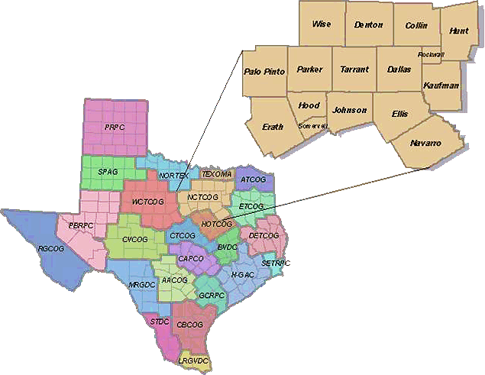
About NCTCOG
The North Central Texas Council of Governments (NCTCOG) is one of 24 Council of Governments across Texas whose main function is to transcend jurisdictional boundaries to promote sound development and facilitate cooperation among member governments. NCTCOG works on many quality of life issues such as transportation planning, air quality, environmental management, emergency preparedness, workforce development, and more. For information on all Texas regional agencies, visit the Texas Association of Regional Councils.
Visit www.nctcog.org for more information on programs and resources available from NCTCOG.

